Slide 1
dress me up! CMP 784 – PROJECT FINAL PRESENTATION
Presenters:
Tahir Büyükbaşaran
Yusuf Çağrı Öğüt

Slide 2
OVERVIEW OF THE PROJECT

Slide 3
PROBLEM STATEMENT AND MOTIVATION
PROBLEM STATEMENT:
“Creating textual descriptions, comments and suggestions on combinations based on segmented clothing images.”
MOTIVATION:
To create an (objective) outfit combination evaluation model
Adding objectivity by building the evaluation based on choice of population
Building a combination suggestion model, on top of them.

Slide 4
RELATED WORKS

Slide 5
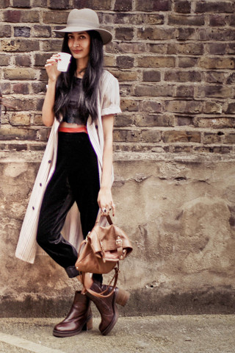
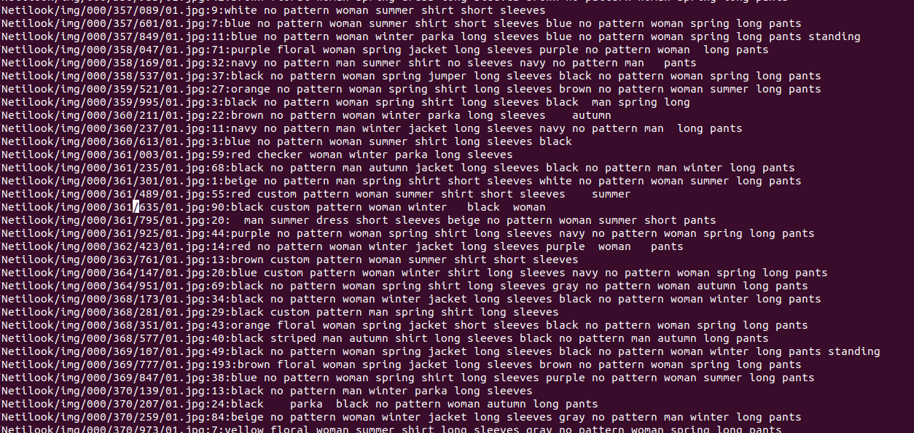
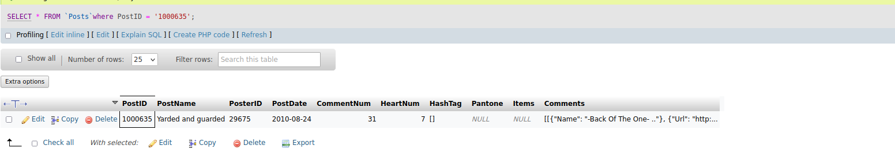
KEY TECHNICAL IDEAS IMAGE CAPTIONING Dataset Preparation
Preprocessing:
Filtering broken images
Text sanitizing (space removal etc.)
3 Datasets combined:
# of comments
Image path
Image text
brown no pattern woman summer dress short sleeves woman
Air Clothing
Image2text, YOLOv3 based
Netilook/img/001/000/635/01.jpg
≥1

Slide 6
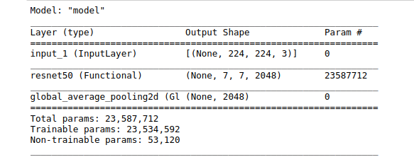
KEY TECHNICAL IDEAS IMAGE CAPTIONING Dataset Preparation
Resnet Based
Classifier layer removed
Inputs resized to 224x224
Image Features
[2048]
Concatenate
Generated Features
[2096]
Netilook/img/001/000/635/01.jpg
Sentence Transformer
Embeddings
[48]
Image Text

Slide 7
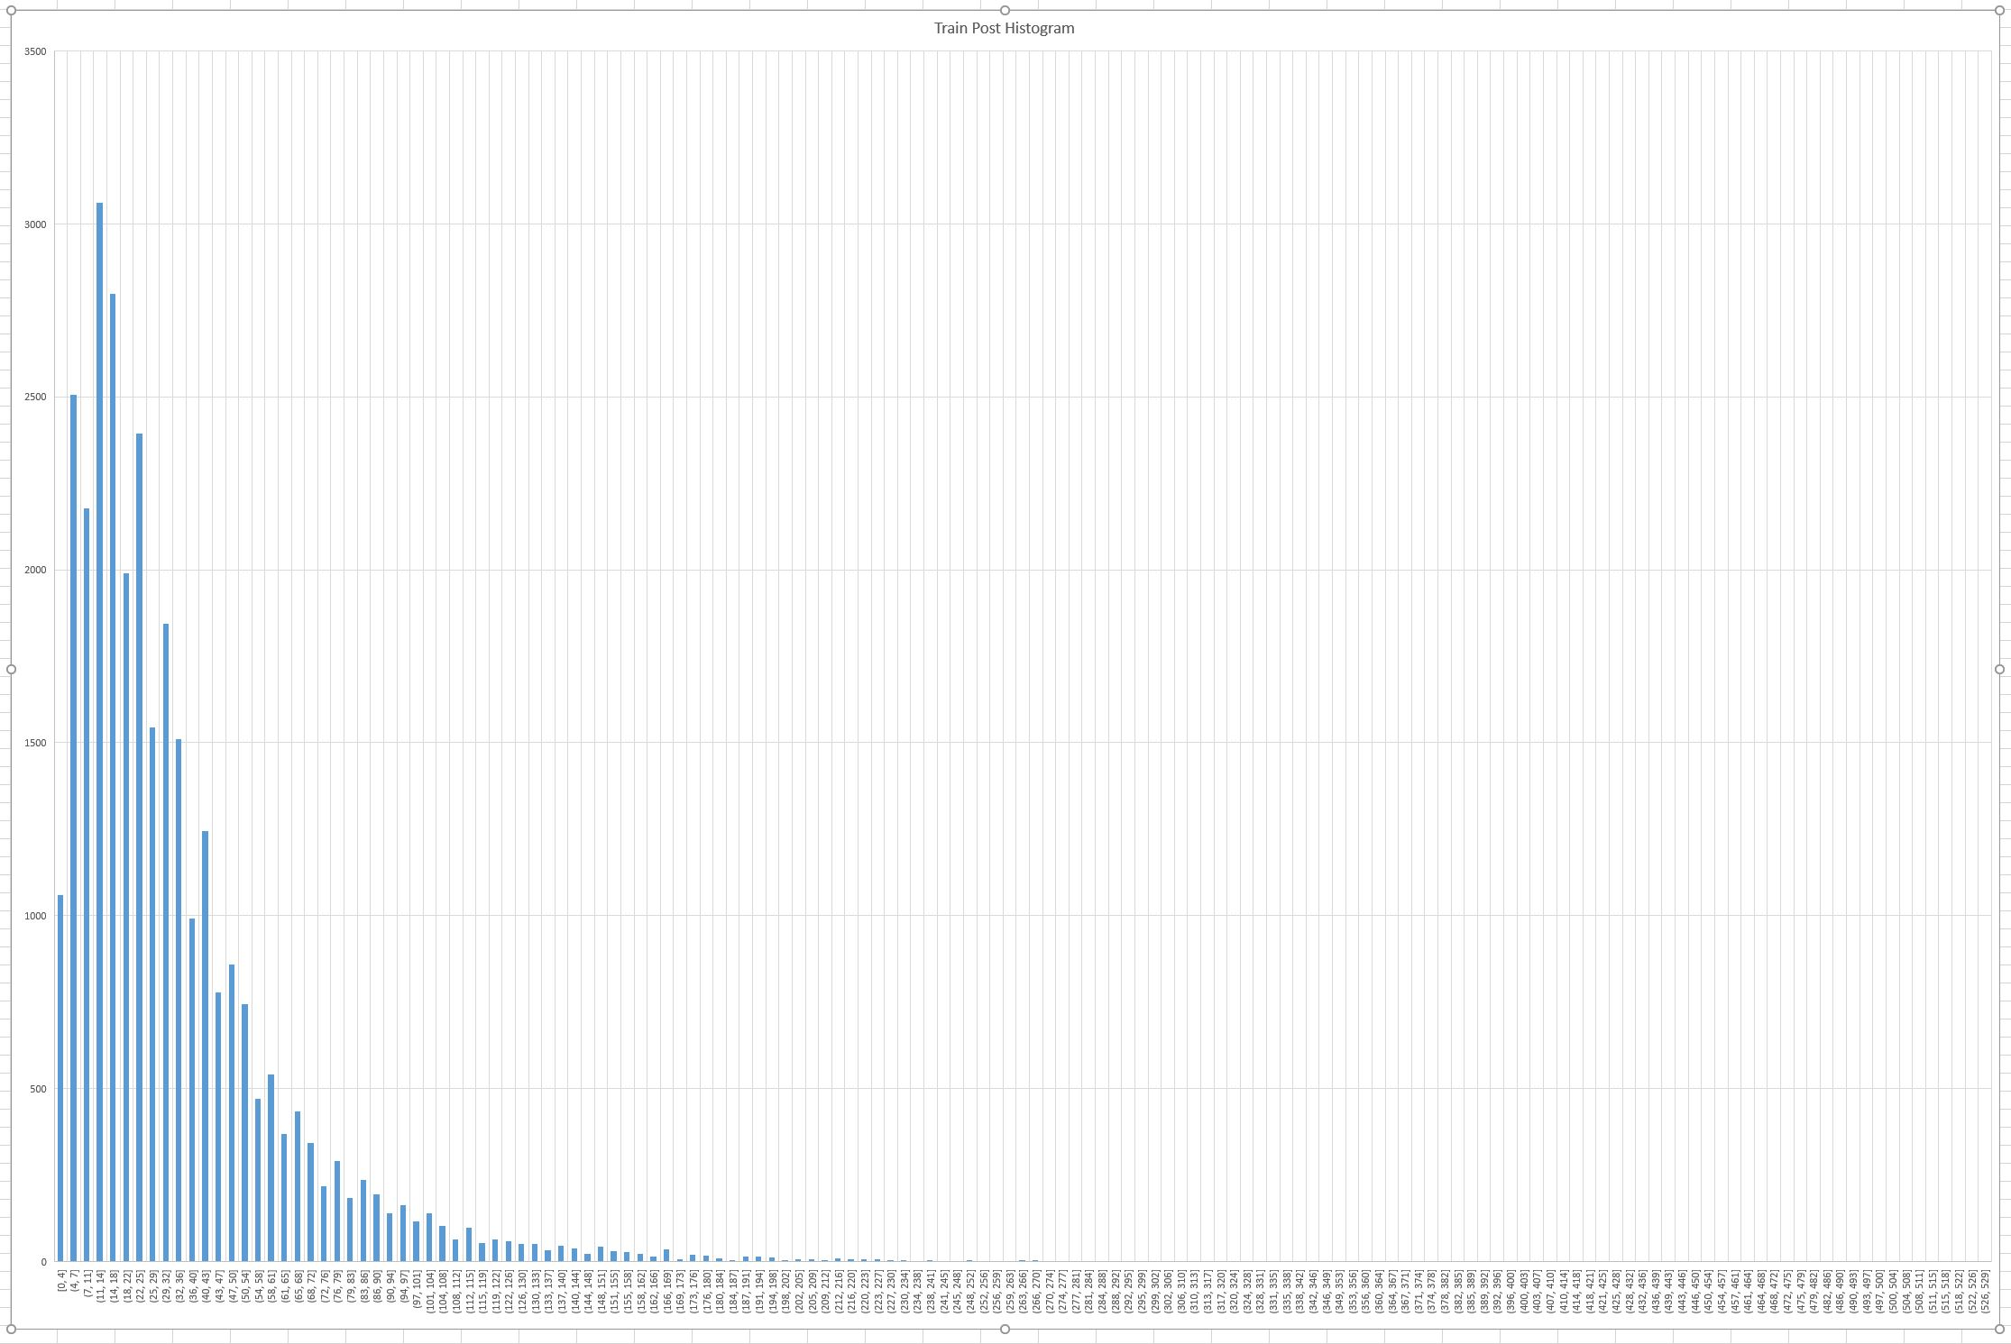

KEY TECHNICAL IDEAS IMAGE CAPTIONING Dataset Preparation
0
1
2
3
4
5
6
7

Slide 8
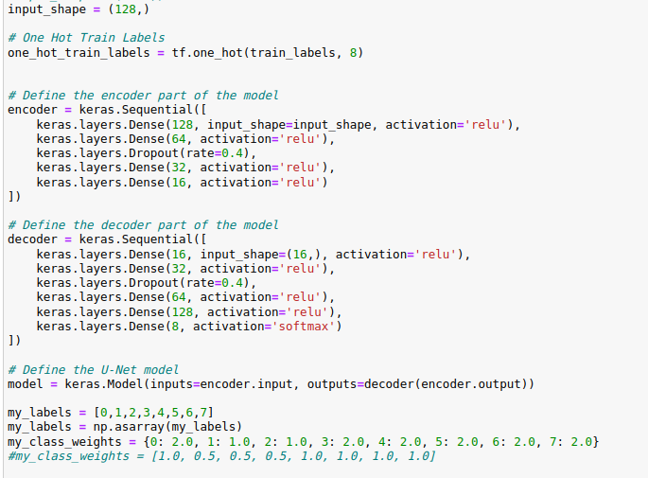
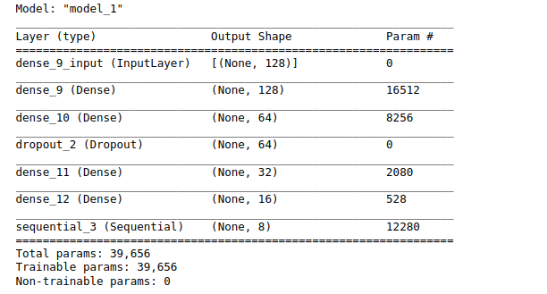
KEY TECHNICAL IDEAS IMAGE CAPTIONING Network Training
Feature Reduction with PCA
(to avoid overfitting)
Data concentrated in some categories
U-Net Model
Dropout for avoiding overfitting
Class weights due to imbalanced dataset
Smooth Transition
8-headed classifier

Slide 9
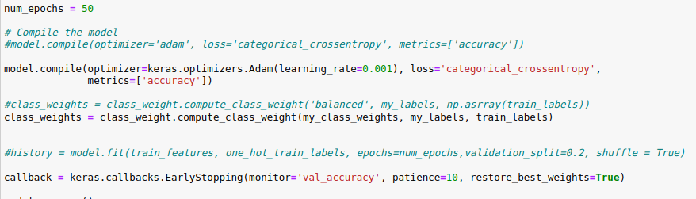
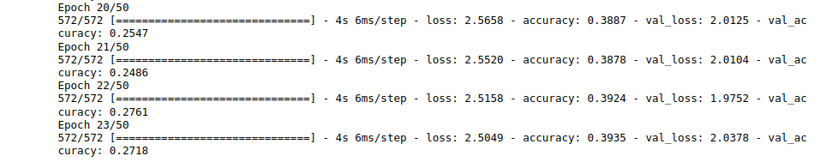
KEY TECHNICAL IDEAS IMAGE CAPTIONING Network Training
To avoid overfitting
“Wait 10 epochs to see if validation accuracy is not increasing”
Validation Accuracy is not increasing

Slide 10
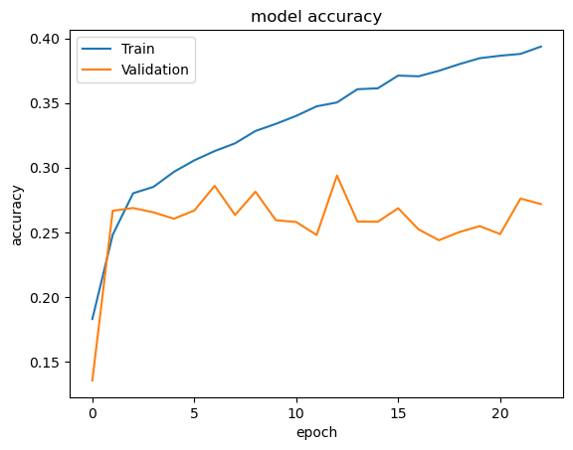
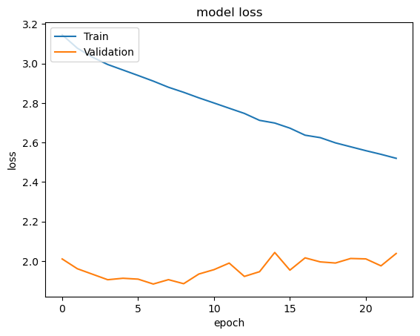
KEY TECHNICAL IDEAS IMAGE CAPTIONING Network Training
# of epoch increases
Training loss decreases
Validation loss doesn’t decrease
# of epoch increases
Training accuracy increases
Validation accuracy doesn’t increase
> Could be due to dataset

Slide 11
KEY TECHNICAL IDEAS SUGGESTION MODEL
sent2vec, Bert Language Model
GOAL: Try to find the most similar annotation in one higher category

Slide 12
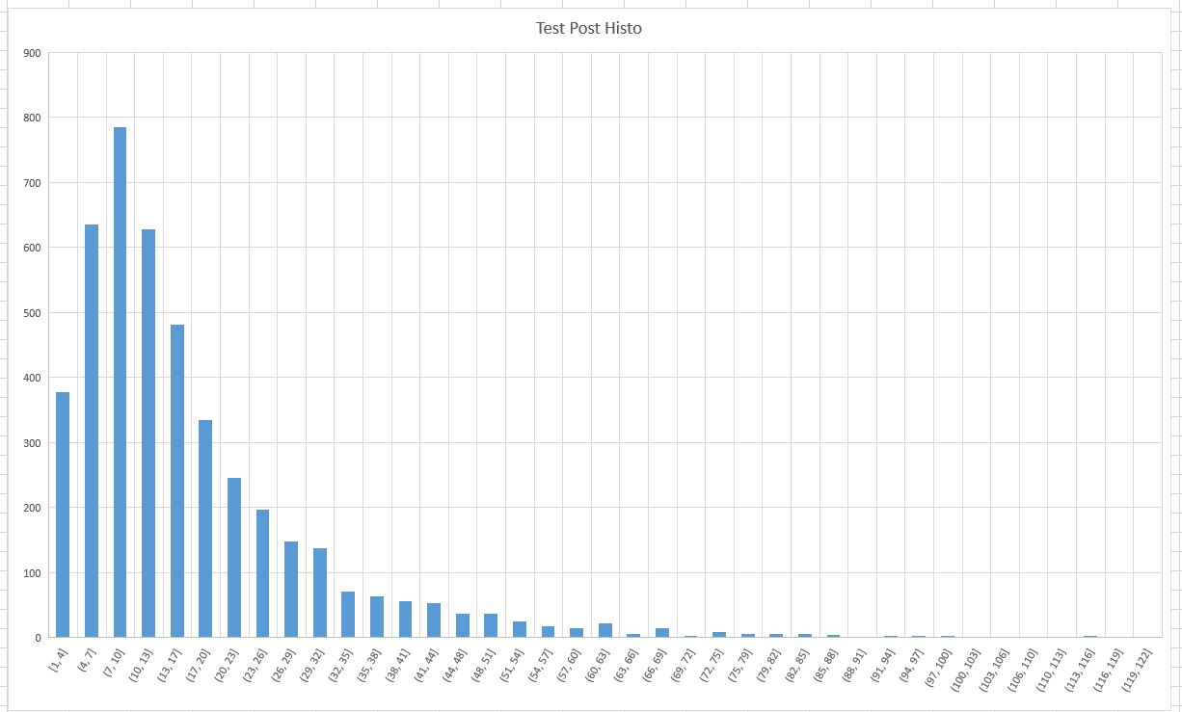
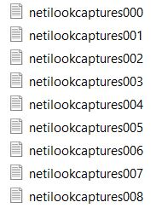
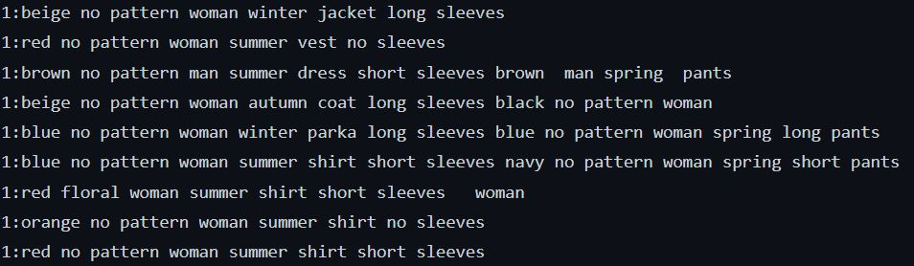
KEY TECHNICAL IDEAS SUGGESTION MODEL
Category “1”

Slide 13

Vector embedding for sentences
Vectorize each category
Easy to compute similarity between sentences

Slide 14
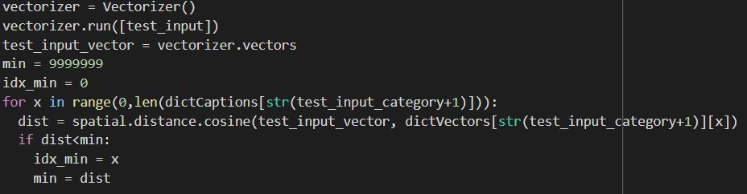
Search for closest vector embedding in space

Slide 16
STRENGTHS AND WEAKNESSES
bütün image yerine sadece kıyafet olsa sonuç daha iyi olabilirdi
turuncu arkaplanda kıyafetleri turuncu sanıyor
kıyafet ayıklansa daha yüksek doğruluk olabilirdi

Slide 17
YOUR QUESTIONS

Slide 18
THANK YOU FOR YOUR TIME!

